Slide 1
Presentation Skills
Prepared for Principles of Marketing Portion of Category Analyst Modules

Slide 2
Focal Areas
1. Slide Design
PowerPoint Rules
Presentation Delivery

Slide 3
Slide Design
Choose Color wisely as to not detract from the presentation
Font size can also detract from the readers understanding of the material
Limit animations for professional presentations
Keep pictures to the point
Notes:
Make sure the colors are easy to read when projected and printed. Make sure font doesn’t disappear into background color. Also, remember that color preferences are subjective so try to keep it neutral
Be conscious of font size; small font is hard to read at back of room. This font is set at “20” so if it looks good to you now, keep it in mind for when you are making your slides. Also, serifed fonts are often easier to read in presentations. (I give examples of serif and sans serif since most students don’t know the difference)
Keep animation professional. Too much animation can make presentation hard to load and slow down the presentation. (I offer an example of painfully slow animation and talk about how it kills the flow of your presentation)
Any pictures or clipart should be professional in appearance and relevant to the material. Always avoid the “drawings” and choose “photos” when using pictures. When possible, use actual photos of the business, executive, etc. Do not over do it.

Slide 4
Power Point Guidlines
Keep each bullet to eight words or less
Keep length appropriate to the presentation
Be more than a Power Point mouthpiece
KISS, or Keep It Simple Silly!
Notes:
Note: Guidelines is misspelled to highlight the importance of proof reading
Choose words wisely and don’t load slides with too much information. Some sources say you should use no more than 8words per bulleted point/sentence.
Just because it is easy to create slides, don’t keep making them. Look at each slide and ask, “Is this slide really necessary?” Also, for professional presentations, try not to go over 25 minutes as studies show your audience loses interest after 25. (however, as a student, you might be required for longer)
“Over Tweaking” - You can spend many hours making minor adjustments to slides and wasting time that could be used to add richness to the content instead of aesthetic changes.
Slides should be a reinforcement for the presenter, not a replacement. Do not be an audio aid for the slides.
The next slide shows the “slide sorter” view. Here, you can see how the flow of your presentation is progressing. Looking at all of the slides at the same time, you can see which can be deleted, if there are any visual problems, and if the order is appropriate.** (For this point, I was going to show them the “slide sorter” view so they can see what I am talking about.)
FINAL NOTE: Ask if anyone has any additional comments about this slide…see if they notice the typos. Explain the importance of proof-reading and spell-checking. Explain I left them there on purpose so they would think I was an idiot or unprofessoinal…to show how quickly we judge typos on a slide. Usually, when I first start on this slide, a few start whispering. I just keep going. At the very end, I ask for any additional suggestions for how to prepare slides…waiting for someone to tell me I forgot to proof read.

Slide 5
Be Friend your Slide Sorter
People tend to remember things better when things are grouped together
Using the slide sorter to group like material can aide the presenter in giving the presentation a smoother flow.
Notes:
Please not a slide sorter image is presented within the PowerPoint slide. This can be used to demonstrate how to group similar ideas together to make a more connected presentation.

Slide 6
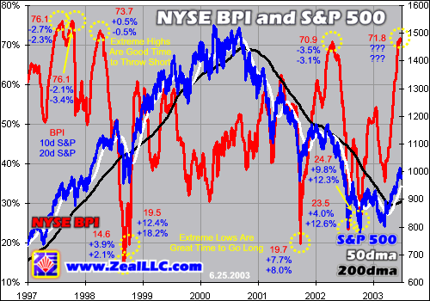
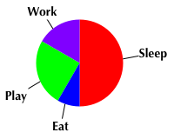
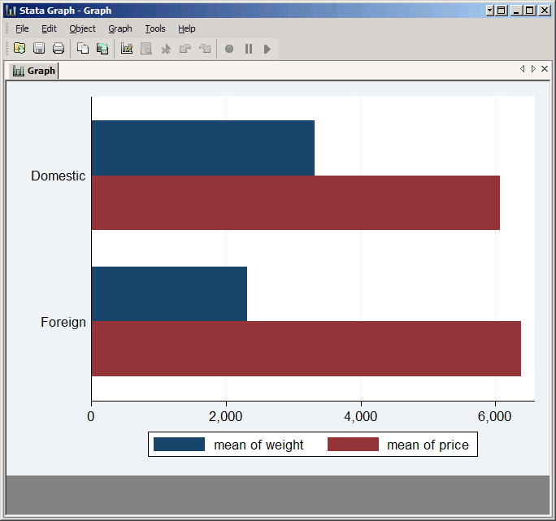
Graphs
Graphs
People often put too much data in graphs
Pie charts, bar charts, and line charts work well
Side by side comparisons also work well

Slide 7
Videos and Sound
Videos and Sounds
Good at illustrating concrete examples
Easy to implement
Audio is also easy to implement to show an interview
Avoid superfluous videos or sounds as they can detract from credibility

Slide 8
Presentation Do’s and Don’ts
Three basic sections
The opening – 10 to 20% of presentation
What’s your rush?
Introduce
The body – 70 -80% of presentation
The closing – 10 to 20% of presentation
Don’t forget the “Thank You”
Notes:
– capture attention, lead in to topic
– key points, each followed by a few facts
– summary of content, then a memorable statement or call to action (depending on purpose of the presentation), examples, or stories to back it up

Slide 9
Presentation Do’s and Don’ts
Preparing the presentation
Above all, know the material
Determine the purpose of the presentation
Consider the audience
Handouts should reinforce, not duplicate

Slide 10
Presentation Do’s and Don’ts
Delivering the presentation
Nervous is good
Dress for confidence
Be the early bird
Slow is good
Have a backup plan
Project your voice
Keep eye contact

Slide 11
Thank You
Questions?
Notes:
References
Sara Green Williams, Meis Student Development Center at Indiana State University, 2014.
Garr Reynolds, Top Ten Slide Tips, accessed online at http://www.garrreynolds.com/preso-tips/design/, Feb, 2014.

