Slide 1
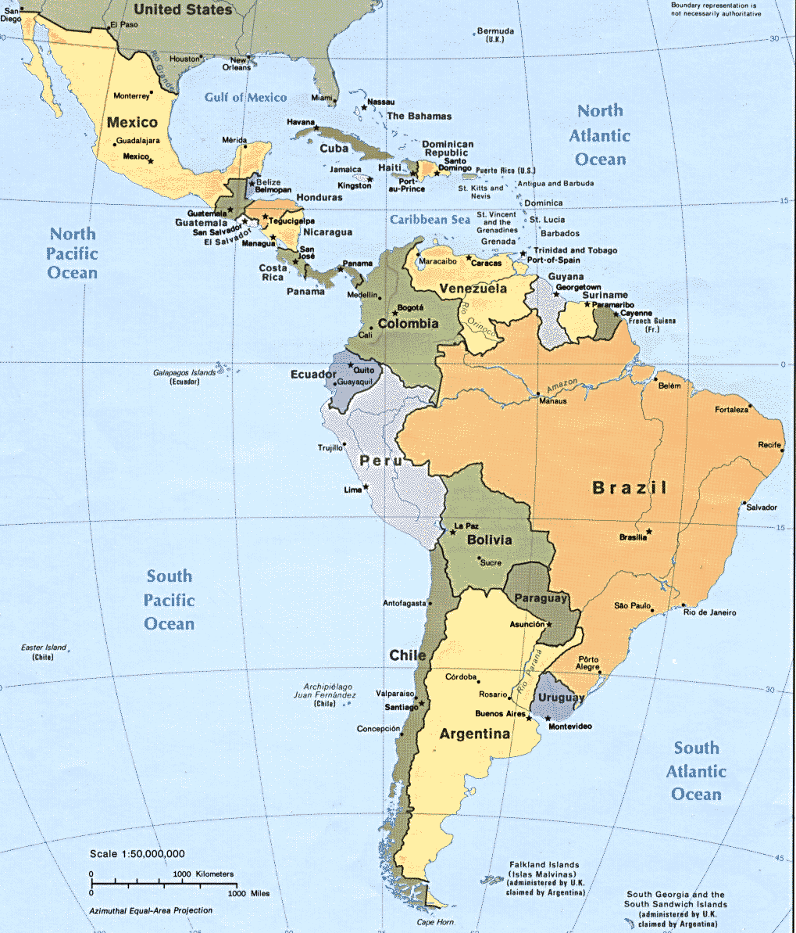
Human Resource Development (1): Preparation for Internationalization
Latin America
Notes:
Script: Welcome to the Expatriate Development Series on Latin America.

Slide 2
Introduction Expatriate Development: Latin America
Human Resource Development
Business Application
Personal Assessment
International Leadership
Personal Development
Notes:
Script: The Expatriate Development Series on Latin America is comprised of five modules:

Slide 3
International Retailing: Human Resource Development
Human Resource Development
Business Application
Personal Assessment
International Leadership
Personal Development
Preparation for Internationalization
Standard Operating Procedure (SOPs)
Employee Development
Performance Appraisal
Notes:
Script: For this section we will review Human Resource Development, which examines cultural aspects as well as best practices for the expatriate. We will examine the following areas related to Human resources in the international environment.

Slide 4
Human Resource Development
Preparation for Internationalization (1)
Standard Operating Procedures (2)
Employee Development (3)
Performance Appraisals
(4)
Human Resource Development
Notes:
In this module on Human Resource Development, we will focus on Preparation for Internationalization.

Slide 5
Preparation for Internationalization
Increased Activities
Expatriates
Preparation for Internationali-zation
Latin America
Market Development
Notes:
Preparation for Internationalization involve three components: Increased Activities, Expatriates, and Latin America Market Development.

Slide 6
Preparation for Internationalization
Increased Activities
Human Resources in the International Environment
International Activities
Host Country Activities
Internal Activities
Expatriates
Expatriates Needs
Latin America Market Development
Political Development
Marketplace Development
Social Development
Notes:
These categories are divided into these subcategories, each of which will be explained in later slides.

Slide 7
Increased Activities
Human Resources in the International Environment
International Activities
Host Country Activities
Internal Activities
Notes:
The increased activities can be divided into four broad categories; Human Resources in the International Environment,
International Activities, Host Country Activities, and Internal Activities.
First we will examine Human Resources in the International Environment.

Slide 8
Increased Activities
Human Resources in the international environment
More activities must be engaged
Notes:
Script: Companies wishing to embark on internationalizing need to understand the complex nature of human resources as you enter additional countries and cultures.
In addition to many legal challenges which will need to be overcome in the international environment, many social and ethical dilemmas will also need to be addressed.
Let’s begin to look at just a few of the additional activities which Human Resources will need to engage in for internationalization.

Slide 9
Increased Activities
International Activities
Taxation
Compensation
Benefits
Governmental compliance
Relocation
Socialization
Notes:
Script: One of the first activities to examine would be taxation. Taxation is not uniform across countries and in some cases is not uniform within countries. Special governmental zones or local tax quota’s may apply to a particular type of employment or industry requiring management of multiple income tax rates.
Second compensation in some cases is ruled by mandated national minimums. In many cases throughout the Latin American countries, compensation may be governed by the relationship between company members and not an organizational chart or governmental rules. These relationships, which may disrupt pay scales and bracketing may require maintenance as opposed to removal. Social pressures within Latin America are often more important than traditional western style business practices.
Benefits are another area which is often governed by local and national traditions. Benefits which can be demonstrated to others are often preferred over salary. Time off, cars or drivers, apartments or expense accounts are often the topic of conversation and negotiation rather than salary.
Governmental compliance is often complex in Latin America. While the national laws are relatively easy to comply with many local “laws” or procedures are often more a matter of tradition or expectation rather than strict legal guidelines, but require compliance non-the-less.
Finally, one of human resources most important activities when internationalizing is the relocation and socialization of expatriate managers. The process of identifying good candidates, making a smooth transition to the international environment and then providing support to encourage rapid socialization into the new culture are all critical components to the successful implementation of an international strategy.
Additionally human resources may also need activities particular to the host country.

Slide 10
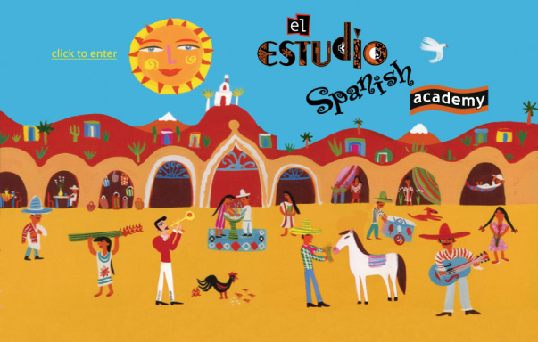
Increased Activities
Host Country Activities
Government relations
Language
Unique attributes
Labor market
Competition
Notes:
Script: Activities related to specific host countries can cover a variety of different categories.
Governmental relations are often required in new international environments. Differing laws related to hours of operation, employee age, store size or location all may require positive governmental relations to provide a smooth entry into a market. In addition to basic store operation issues, shipping and handling of product as well as the product carried in-store itself all may require the benefit of good government relations.
Language may be another barrier. While most countries are said to have a native tongue, many have multiple languages spoken including specific dialects as well as indigenous languages which all may require multiple translators to manage.
Each market may exhibit unique traditions or laws which are not apparent to the outsider. In many cases human resources personnel will need to be on the ground in a market to truly assess the importance of each unique attribute in a market as it relates to the business.
The labor market in each country can vary widely. From skilled to unskilled labor to technical support and level of education. Further customs may inhibit some populations from working in a retail environment or in a particular area with in a store. All of these issues are best assessed from within the host country when seeking an optimum solution.
Another area of host country concern is competition within the marketplace. Most of the issues today can be impacted competition within a host country. The competitive nature of a country may drive cost, labor availability, and governmental oversight to name a few.
These activities can be examined still further from within the international company itself.

Slide 11
Increased Activities
Internal Activities
Multi-cultural training
Employees’ personal lives
Expatriate assignment management
Global Future Leaders
Notes:
Script: Within the company human resources may be required to engage in multi-cultural training for the host country employees as well as the expatriate to help explain cultural differences and to mediate workable solutions.
Employees personal lives often a subject not considered a part of the human resources agenda can be an important part of internationalizing. Having host country employees adjust to an expatriates work demands as well as the expatriates family acculturation are all ways the private life can be a topic of discussion with human resources.
Finally expatriate assignment management is an important part of success. Reviewing progress and comfort level and implementing engagement between parent and host companies for the expatriate all require the skill of the human resources department.
For additional understanding you may choose to click the Global Future Leaders block to watch a video about expatriate assignments.

Slide 12
Expatriates
Expatriates Needs
Corporate and HR
Strategy
Policies
Corporate and Host Company
Cultural HR assumptions
Local concerns
Resistance to corporate policies
How to learn
Foreign contemporaries
Foreign marketplace
Read About the Book
Notes:
Script: Before any assignment begins the human resources department needs to insure that the expatriate thoroughly understands human resources strategy and policy from a corporate perspective. Along with this there are assumptions which have been created in conjunction with the host company related to culture which require a full understanding.
Finally the expatriate needs to understand how to be successful in the host country by removing barriers not building them. This is often best accomplished through learning from their host country contemporaries as well as the marketplace in general.
For more about human resources in general click the read about the book hyperlink.

Slide 13
Latin America Market Development
Political Development
Marketplace Development
Social Development
Notes:
Script: The Latin America Market Development can be divided into three categories; Political, Marketplace, and Social Development.
First we will examine Political Development.

Slide 14
Latin America Market Development
Political Development
Colonial Period
Independence
Governmental Oversight
Opportunities in Latin America
Notes:
Script: Most of Latin America experienced a similar political and social development during the colonial period. In large part the nations which comprise Latin America were developed under colonial rule by either Spain or Portugal. The similarity during colonial rule led to similar developments in both social structures and political governance. This is not to say that all Latin American countries are the same, but they exhibit an unusually large number of area’s in which they are similar which was born from the similarity of the colonial rule.
As the first Latin American countries began to emerge from colonial governance other countries quickly followed. This again led to remarkably similar timing and development within Latin American countries. Independence was won with the assistance of charismatic military figures. These same military figures were many of the first independent leaders within Latin America. Democratic structures and separation between civilian and military governance was slow to develop.
As a result of the authoritarian leadership formed under military leadership, businesses historically faced an interventionist business climate. As governments changed military leadership, and civilian leadership heavy regulation of the economy was the norm but varied from populist leanings to more commercial orientations. This lead to complex relationships between the government and business organizations as the climate in which they operated varied by administration.
Now lets examine the development of the marketplace in Latin America.

Slide 15
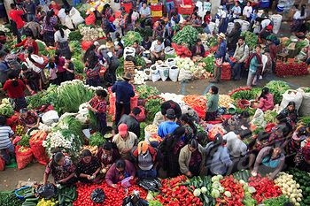
Latin America Market Development
Marketplace Development
Latin American firms ownership
Latin American and the global economy
Notes:
Script: Most companies within Latin American which are native to a Latin American Country began as and continue to be family-owned.
The parochial nature of corporate development was generally in response to the heavy governmental interference in the marketplace. Navigating the changing internal national business climate left little time to develop more international strategies. With the broader stabilization in national governance, interest and success in developing a more global position has increased rapidly. Economically, most Latin American countries are positioned to make substantial forays into the international marketplace. Additionally, this same governmental and economic climate offers substantial opportunities to multi-national corporations to participate in Latin America as well.
What about the social climate?

Slide 16
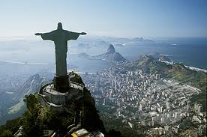
Latin America Market Development
Social Development
Colonial Period
Similarities
Lifestyle
Life Pace
Religion
Notes:
Spring: Unique from virtually all other continents the similarity in the rule of most of Latin America during the colonial period developed a surprisingly homogeneous environment. Most of Latin America shares a common language Spanish followed by Portuguese. They shared their development both in the colonial period and during independence. This developed a markedly similar social structure and traditions.
In addition to these factors Latin American cultures share a common religion in Roman Catholic ism. This powerful part of the social fabric of Latin America is an important common factor which impacts calendars and social events.

