Slide 1
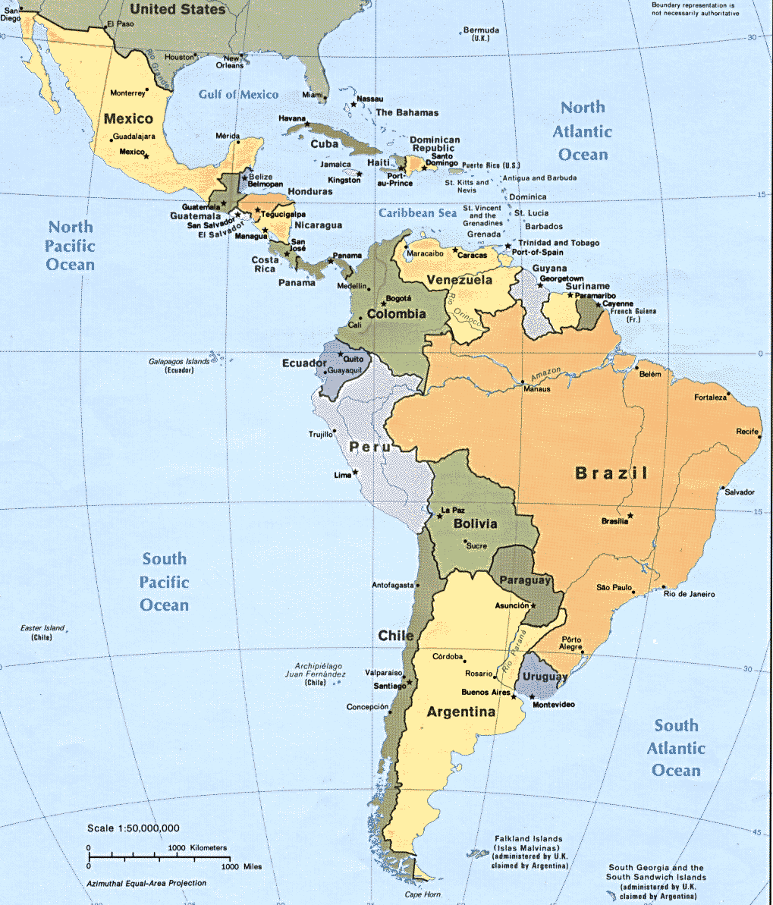
Expatriate Development Series
Latin America: Expatriate Development I
Notes:
Script: Welcome to the fifth and final module which comprises the expatriate development series on Latin America.

Slide 2
Introduction International Retailing: Latin America
Personal Development
Business Application
Personal Assessment
International Leadership
Human Resource Development
Notes:
Script: For this module we will review various aspects which the expatriate should consider for their Personal Development, before undertaking their assignment. Personal development examines language and a variety of social and cultural aspects unique to the countries of Latin America.

Slide 3
International Retailing: Latin America
Personal Development
Personal Assessment
International Leadership
Human Resource Development
Business Application
Language
Topics: Embrace and Avoid
Words, Symbols and Their Meanings
Preparation for Assignment
While on Assignment
Notes:
Script: Throughout this module we will examine the following area’s related to Personal development in the international environment.
These topics will be arranged as follows:
Language
Topics: Which you should Embrace and Avoid while on assignment
Words, Symbols and Their Meanings
Things to do in Preparation for your Assignment
and
Things to be prepared for, While on Assignment
We will begin with language

Slide 4
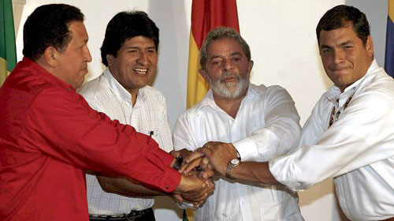
Topics: Embrace and Avoid
Sports
Politics
Art
Religion
Inter-Cultural Relations
(The former president of Brazil, Lula and other representatives in Latin America
Notes:
Script: Within each of these topics;
Sports
Politics
Art
Religion
Inter-Cultural
There are subjects which should be embraced and others which should be avoided.
First we will examine those which should be embraced

Slide 5
Embrace
Sports
Futbol (soccer)
Baseball
Basketball
Bullfighting
Click here for more information about Bullfighting
Notes:
Script: Futbol (soccer): is the most widely played and watched sport. Local and particularly national teams are fervently supported.
Baseball: is a growing a popular sport. Long played in the Caribbean region it is gaining more broad support.
Basketball: is becoming a more popular sport which is gaining viewership and recreational players
Bullfighting: is not practiced universally in Latin America. It is practiced in Peru, Colombia, Mexico, Venezuela and Ecuador. Where this ancient sport is engaged it is closely followed. It is most common and most popular in Mexico. A hyper link is provided if you wish to gather more information about bullfighting.

Slide 6
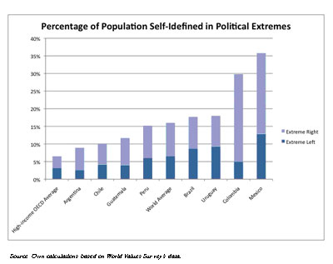
Embrace
Politics
Much more volatile the U.S.
Still some unstable countries
Distinct political parties in Latin America
Notes:
Script: Politics is a topic which inspires much debate in Latin America. Learning and appreciating who participates and how the process operates is appreciated.
Politics in Latin America in general is much more volatile than in the U.S. This is the leading cause for so much discussion. Latin American political parties are much more distinct in their philosophies than political parties in the U.S. When power shifts between political parties in Latin America, much more dramatic change can occur than is typical of political party power change in the U.S.

Slide 7
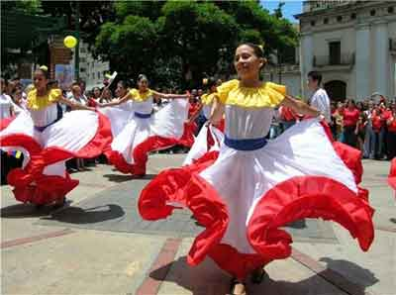
Embrace
The Arts
Art
Poetry
Dance
Music
Theatre
Source: Artwork in LACMA Museum in LA
More information/resources about Art in Latin America
Notes:
Script: Art along with poetry, dance, music and the theatre, all enjoy long and important histories throughout Latin America. Many nations have national dances and music styles. Additionally, many Latin American countries have local art styles with champions or hero’s who represent that art. Many Latin American countries have important theatrical works which serve to represent their nation.
Engaging with the art world of the host country can be not only very satisfying for the expatriate, it can often aid in developing important relationships during the assignment.
The arts are considered part of the good life which most Latin Americans are striving for. A more detailed discussion of the arts can be found by selecting eth ART hyperlink.

Slide 8
Embrace
Religion
90 % of population in Latin America is Catholic
Not necessarily, regular or exclusive
Freedom to participate in a folk or local tradition
Increasing number of Protestants
Acceptable to discuss about various religions
Notes:
Script: Religion and particularly the history of religion within your host country is a topic which can be discussed. The religious make up of the countries across Latin America is as high as 90% Catholic.
While countries in Latin America profess to be 90% catholic participation in that religion is not always regular or necessarily exclusive. Other established protestant religions have made in-roads into Latin America. However, it is the inclusion of local folk religions which accounts for most of the variation. It is common in Latin America for people to claim an affiliation with an established religion, either protestant or catholic, and engage in a folk or local traditions as well. Evangelizing by other mainstream religions is widespread, so discussing religion from a perspective of gaining knowledge is acceptable

Slide 9
Embrace
Inter-Cultural Relations
A variety of cultural orientations
Existence of complex culture
Notes:
Script: The cultural traditions within each nation in Latin America, is comprised of a variety of cultural orientations.
While largely settled by the Spanish and Portuguese during the colonial period there were many proud cultures which existed across Latin America prior to colonization. Mayan, and Inca civilizations were culturally sophisticated and well established by colonial times. To this day virtually every Latin American country continues a rich cultural tradition which in many cases includes the existing indigenous peoples. Each country has generated a unique culture and conversations regarding the cultural history and traditions is not only acceptable it is appreciated.
While these area’s can be embraced certain aspects of them should be avoided which will be discussed next.

Slide 10
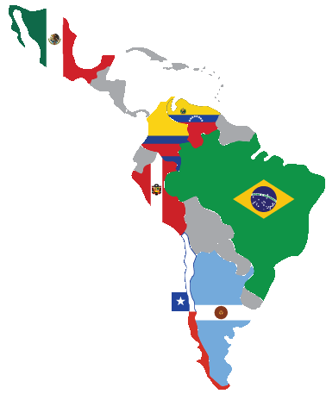
Avoid
Sports
Politics
Art
Religion
Inter-Cultural Issues
Notes:
Script: The discussion of topics to avoid will follow the same order as the embrace topics which was:
Sports
Politics
Art
Religion
Inter-Cultural
We will begin with sports.

Slide 11
Avoid
Sports
Soccer is most popular
Avoid a comparison of different teams
Try to show interests in soccer
Ask about rules and popular teams to your host
Notes:
Script: Latin Americans are passionate about their sports, particularly futbol (soccer in the U.S.).
Entering into conversations which are focused on a comparison of the host countries teams to other countries is not welcome. In fact inviting this comparison where there are strong regional teams to other regional teams will likewise not be welcomed.
Additionally, continually entering into conversations about U.S. teams is also not welcome. It is best to show a preference for the local teams and show an interest in their performance. If however your host were to make inquiries about U.S. sports, you should feel welcome to express your thoughts in a brief and open ended manner. This allows for your host to ask for more details and not feel inundated with information. Your response to your host should not result in a comparison between the your team(s) and your hosts favorite teams.

Slide 12
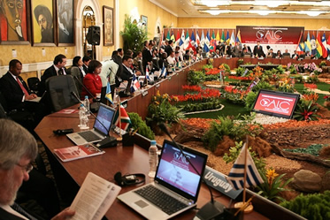
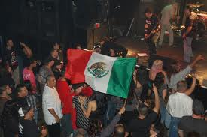
Avoid
Politics
Taking sides is never good idea
Try to engaging for understanding
Avoid presenting your position
Notes:
Script: Taking sides or expressing comparisons to other nations politics is never a good idea in Latin America.
It is not to your benefit to place yourself in the middle of the political world in Latin America. Political agendas of neighboring countries as well as internal alliances can change quickly.
Political conversations should be about engaging in understanding, not about staking out your position. You may find that pressure will be brought to bear to support one party or candidate. You should resist that at all costs. However, should their be a need to profess support due to business with the government or intense internal pressure, always consult with the home office before expressing any support or affiliations.

Slide 13
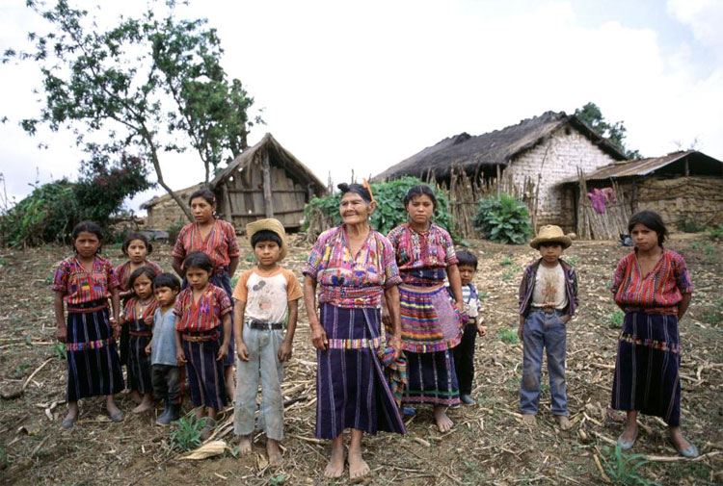
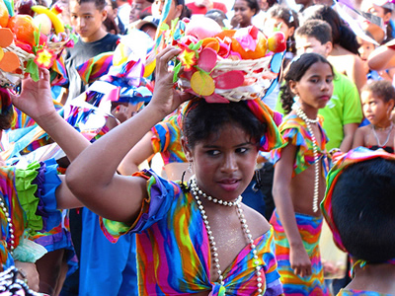
Avoid
The Arts
Avoid comparing local to U.S. and European cultures
Respect indigenous and local cultures
Comparisons of cultures are not welcomed
Guatemala Indigenous family reserve
Local Venezuelan women
Notes:
Script: While much of the art of Latin America is steeped in the European tradition, each country has its own rich history in the arts. Comparisons to other cultural icons which place the Latin American art tradition in an inferior light is not recommended. Comparisons, to other cultures or countries when in Latin America in general not welcomed.
Art should be addressed from a within country experience, expressing appreciation for the gift of the artist.

Slide 14
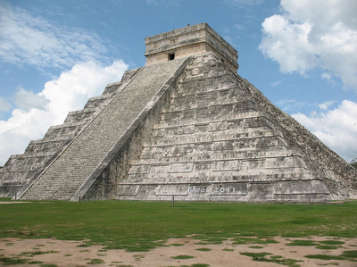
Avoid
Religion
Not appropriate for evangelizing others
Try to learn religious history
Explore religious sites
Chichen Itza, Mexico
Notes:
Script: Expatriate assignments are not the appropriate venue for evangelizing. Seeking information to learn about religious history and exploring religious sites is welcome. Proselytizing is not. The Catholic and indigenous religious orientations are strong and proudly engaged. Missionaries and evangelists should be left with the responsibility to generate support for other faith traditions.

Slide 15
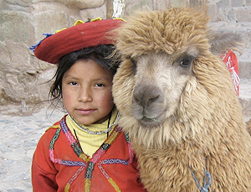
Avoid
Inter-Cultural Issues
Indigenous peoples sensitivities
Do not compare your culture and host country culture/ history/ indigenousness
Ask local people to be your partner
Notes:
Script: While there are rich indigenous histories throughout Latin America, there are also difficult and sometimes strained histories which require sensitivity.
Not unlike the history in the US with Native American populations, which often require a nuanced discussion and sensitivity to culturally based points of view.
Therefore it is best to seek information about these relationships. Do not place yourself in the position trying to compare the host countries history to that of the U.S. Do not try to explain the past or attempt to compensate for historical issues.
This is of course assuming that your goal as a representative of your firm is not to make those changes. If your company as a form of corporate social responsibility seeks to aid indigenous populations, than reference to your home countries struggles as a foundation for seeking change may be beneficial. However, whatever changes or aid is being offered they should be given as a response to a request from within the host country. In no case should the offer to help institute change be solely from a U.S. initiative.
The next series of screens will help to familiarize you with symbols and signage which are common throughout Latin America.

Slide 16
Preparation for Assignment
Financial Planning
Corporate Contact Planning
Personal Connections
Contractual Obligations
Language Skills
Food and Culture Experimentation
Planning for Your Family
Notes:
Script: The preparations for your assignment include:
Financial Planning
Corporate Contact Planning
Personal Connections
Contractual Obligations
Language Skills
Food and Culture Experimentation
Family Planning
We will begin with financial planning.

Slide 17
Preparation for Assignment
Financial Planning
Home
Vehicles
Insurance
Notes:
Script: Prior to your assignment, be sure that you meet with Human Resource and/or a financial and/or insurance advisor to discuss the impact of the assignment on your home. Depending on the arrangements for your family and the assignment your home may need to be rented, sold or regularly maintenanced in your absence. Your decision regarding your home will impact the type of insurance you will need for this asset.
Similar to your home your automobile, boat, etc. may also require selling or storage. Again your decision will impact the insurance you need for this asset.
Some expatriates may wish to engage additional insurance related to life and health while on assignment for themselves as well as family members. Discuss this as well with an advisor of HR.
Next we will discuss your plans for contact with the home office.

Slide 18
Preparation for Assignment
Corporate Contact Planning
Human Resources
Departmental
Executive
Notes:
Script: Expatriates should be assigned or request to have an individual with which to interact in Human Resources for the duration of the assignment. This allows for ready access and the chance to build a rapport with your representative. This person should be well versed in international assignments.
Within or across departments if your position is integrative, you should develop contacts with people who can keep you abreast of happenings at the corporate office. Your assignment at some point will end and, you will likely return to the corporate office. You should be up to speed on the events in your absence so you are prepared to contribute upon your return. These contacts need not be of a management level. Often if you have a good relationship with an executive assistant or secretary you can get more and better information. Do not rely simply on email, keep the relationship grounded in actual conversation. In addition to phones, internet based option like SKYPE can be of assistance offering not only voice but video.
Establishing a contact within the executive ranks is beneficial for any expatriate. You would have someone you could seek advice from for complications which may arise, as well as discuss your successes. Further, it helps to keep you in the mind of executives who may have a hand in placing you upon your return. This type of relationship requires time. If you have not had regular access to a senior executive, establish the relationship with the executive you have had regular contact with.
Next we will examine personal contacts.

Slide 19
Preparation for Assignment
Personal Connections
Social Media
Broad Band Communication
Notes:
Script: Maintaining personal relations is easier today and much less expensive than in years past, through the use of the internet. Using social media tools like Facebook, Linkedin etc. you have the opportunity to stay in touch with many family, friends and associates. Additionally, you can host your own web site or blog which is also helpful. In many cases you can develop both for little to no cost. This allows for even more communication between you and others.
Skype and google talk are also tools that allow for video and phone connections which in many cases are free across the internet. Again allowing you to maintain contact with many family, friends and associates.
Remember that the internet is available to all. Do not share information about your assignment over the internet. That type of information should be through work secure means. Should you wish to discuss some of your work related dealings look into password protection added to your website or blog to maintain confidentiality.
Next we review your contractual obligations while on assignment.

Slide 20
Preparation for Assignment
Contractual Obligations
Make sure to review any obligations regarding your employment
Business
Personal obligations
Notes:
Script: Be sure to review any obligations which are binding regarding your employment. Staying longer or returning early from an assignment can often cause legal and financial issues between you and your firm. Performance on the assignment may also have consequences which are pre-determined.
Financial incentives may be tied to benchmark goals which will need to be followed and achieved.
Review allowances which are firm provided. Make sure you are aware if you are making decisions which cause you to supplement the corporate financial allowance. As well, review how allowances are dispensed, and if unused allowances need to be returned. Finally review all of the documentation which may be required associated with the allowances. Be sure to maintain an accurate file of all of the necessary paperwork.
Personal obligations are often not removed because you have been sent on assignment. Gym memberships, storage units, lease breakage, early car lease return, clubs and membership dues and fees, may all require fees or significant penalties to break. First you should check to see if any obligation has the opportunity to go dormant until you return which may avoid both fees and penalties. Also check with your Human Resource department and see which if any of these obligation fees or penalties can be covered by the firm. Be sure as well to maintain any documentation to support reimbursement.
Next we will review language skills.

Slide 21
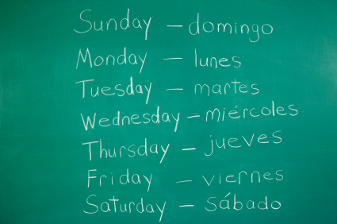
Preparation for Assignment
Language Skills
Try to learn basic expression in local language
Try to take language programs
Notes:
Script: Prior to your assignment it would benefit you to assess your language skills associated with the host country.
If your skills are insufficient look for methods to improve. Often companies, like the military, have a recommended language program. In a short period of time you can gain a cursory understanding of and ability to use words or phrases. Further, these programs can introduce words to you that will become more familiar with time. Critical to your assignment even if the country readily speaks English is to learn the appropriate greetings, please, thank you and requests for assistance for the language of your assignment. A small amount of effort can yield big benefits.
Next we explore food and culture.

Slide 22
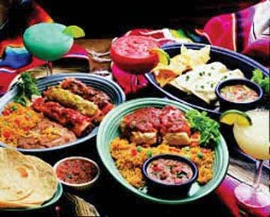
Preparation for Assignment
Food and Culture Experimentation
Familiarize yourself with the food and culture
Try sampling several Latin foods
You can find information about Latin food through various sources
Comida Tipica
Notes:
Script: It is often a good idea to familiarize yourself with the food and culture of the country you are to visit. In the U.S. it is possible to find many examples of Latin cuisine for you to try. Additionally, many web sites including those of the host country, offer Latin food recipes which you could make at home to try. Particularly worth exploring are the “national” dishes and condiments. This will also help you in a dinner setting by being able to find a popular menu item with which you are familiar.
It is also recommended to visit a library, museum or web sites to gather cultural information for your assignment. This type of preparation will give you an appreciation for the style, colors, humor and speech rhythms of the assignment country. Further it gives you the ability to speak with confidence on some cultural issues and provides a foundation for further learning.
Next we will examine planning for you family.

Slide 23
Preparation for Assignment
Planning for Your Family
With family members
Prepare yourself before them
Without family members
Check availability of international communication channels
Notes:
Script: The preparations you are making for your assignment do not occur in a vacuum. Your family even if they are not going on the assignment should be involved in your preparations. This will help get them comfortable with your new life situation and give them a reference point when you are communicating from abroad. If they are not travelling with you, be sure to set up communication with them as we described earlier. Bear in mind that your location may be on a significantly different time zone which requires planning for communication.
Additionally, if they are staying at home, you will need to speak with Human Resources regarding adjustments in salary or allowances to avoid unanticipated financial burdens caused by your assignment for your family.
Should your family be joining you, then involving them in all the preparatory work will be as valuable to them as to you. In fact food and language, as they will be more involved with these on a regular basis, may be in fact more important for them. You may also find that your children should you have them can be extremely helpful with language as they are generally quicker at picking up new language skills.
Next we will examine what you should prepare for while on assignment.

Slide 24
On Assignment
Network Maintenance
Network Development
Family Engagement
Notes:
Script: While on your assignment you will want to try to be involved in:
Network Maintenance
Network Development
Family Engagement
These will all be beneficial to you while on assignment and beyond.
First we will examine network maintenance.

Slide 25
On Assignment
Network Maintenance
Maintain your professional and personal networks
Reduce the sense of isolation after returning to home
Help you to re-settle down after the assignment
Notes:
Script: While on assignment you will need to plan time to work on maintaining not only your professional but your personal network. You will be returning at some point and will want to pick up where you left off.
Both of these networks offer tremendous support and assistance while on your assignment. They will not take care of themselves so you will need to invest the time necessary to maintain contact both in your professional and personal arena’s.
Using all the internet based tools described earlier, plus traditional phone and mail you can successfully maintain association with work and friends.
You will also find that maintaining these relationships helps to reduce the sense of isolation which can often be associated with an expatriate assignment.
Next we examine developing of new networks.

Slide 26
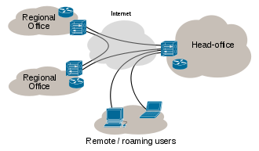
On Assignment
Network Development
Develop a new and robust network while on assignment
Help you to bring potential benefits from relationships on assignments
Notes:
Script: You will want to develop a new and robust network of professional and personal contacts associated with your assignment, which you will want to maintain after your assignment is completed. The contacts you make while on assignment can be valuable to you throughout the balance of your career and your personal life.
These contacts may reenter your world as they change their assignments and as companies become more integrated. Furthermore, you may find yourself back on another assignment and these contacts would make for a much smoother transition.
The time you take to generate strong networking relationships with associates from the host country is extremely well spent. These networks can often be some of the most valuable “take aways” you can have from your assignment.
The final area we will explore is engaging the family in the new environment.

Slide 27
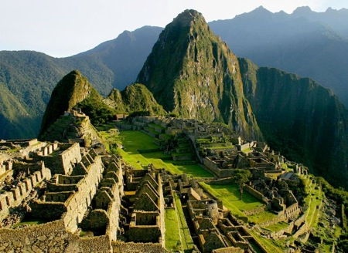
On Assignment
Family Engagement
With family members on assignment
Visit Historic Sites: Machu Picchu
Without family members on assignment
Notes:
Script: While on assignment you will want to have either a) plans to keep the family occupied in your absence or b) plans to engage with them in the new environment.
In the case that your family will not be on assignment with you, you will need to provide as much stability as possible in your absence. Keeping their home life as stable as possible provides a sense of security for them while you are away. Involving them as much as possible in you life while on assignment can give them a sense of the adventure that you are on. In combination, these help to build a feeling of togetherness even though you are separated.
If on the other hand your family will be joining you on your assignment you will want to provide as much stimulation as possible. Working in advance on plans for trips and social events can help them appreciate their new albeit temporary home. Seek out local advice on festivals and holidays as well as vacation, cultural and historic sites to visit. While on the assignment you will have the opportunity to truly embrace the culture of your new home.
Additionally, your company may allow for return trips to the states while on assignment. Planning for those trips should begin early providing an anchor point for contact back home. The timing can alter, but the plan itself often provides comfort to those who are unsure about living in the host country.

Slide 28
Expatriate Development Series
Latin America: Expatriate Development I
Notes:
Script: This concludes the Expatriate Development Series for Latin America.
We hope you found this valuable in preparing you for your assignment.
This presentation is available to you for your review should you require a refresh.
Thank you for your participation in the Expatriate Development Series for Latin America.

