Slide 1
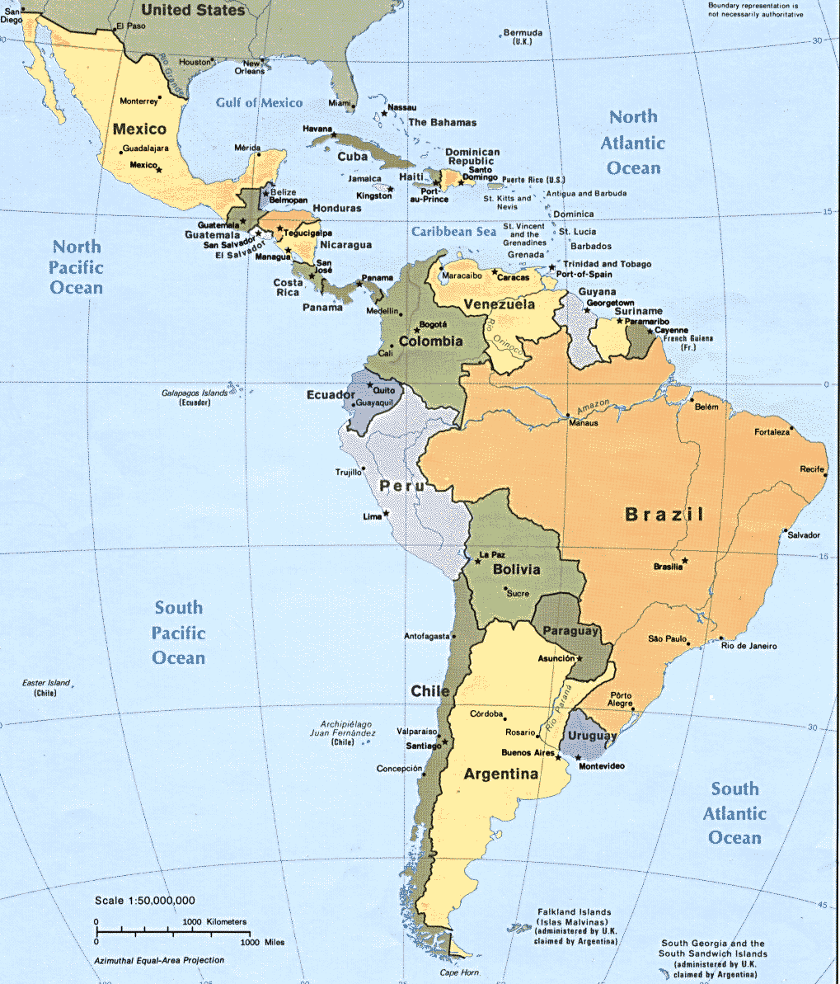

Latin America
Expatriate Development Series:
International Leadership - Standards
Notes:
Script: Welcome to the Expatriate Development Series on Latin America. This module examines the standards portion of international leadership.

Slide 2
Introduction
International Retailing: Latin America
International Leadership
Business Application
Personal Assessment
Personal Development
Human Resource Development
Standards
Motivation
Workplace Behavior
Notes:
Script: The Expatriate Development Series on Latin America is comprised of five modules:
For this section we will review International leadership, with a particular focus on standards.

Slide 3
International Leadership
Standards (Section1)
Motivation & Workplace behavior (Section2)
Power and Position
Goal Setting
Achievement
Cultural Expectations
Corporate Expectations
Navigating Expectations
Adaptability
Influence and Ambassadorship
Direction and Definition
Communication: Role in motivation
Gender differences in leadership
Notes:
International leadership is divided into two modules, which can be seen here. This module will examine the various aspects of international leadership which are associated with standards.

Slide 4

Standards: Power & Position
Authoritarian Leadership is norm
Strong leadership is expected
In general, Men > Women
Notes:
Leadership style in Latin America tends toward authoritarian as a corporate norm. Expatriates should anticipate that they will be expected to present a strong leadership attitude.
This should not be misconstrued as autocratic. By and large Latin American executives represent authority through being decisive and demanding of performance. Performance demands are however tempered by the Latin American desire to have a good life.
Associates will be expected to deliver results, and information. Associates which are expected to provide information, particularly information which leads to a recommendation should only pass that information to their immediate supervisor. Hierarchical protocol set the expectation of advice passing only between a manager and their direct reports.
In general, men hold greater power than women in Latin American industry. Female expats will need to gauge their particular assignment for the level of authority they can display. Additionally, male expats should carefully assess their assignment for the level the firm will be accepting of female advice.

Slide 5


Standards: Power & Position
Inclusion is not necessarily the norm
  Inclusion is growing
  Need to gauge the company for readiness
  While preferred in the U.S. forcing inclusion can result in reduced performance
Notes:
While inclusion is not necessarily the norm in Latin American business, seeking of additional viewpoints is growing. Depending on the progressiveness of the assignment company, an expatriate may find that they are in a position to demonstrate the value of including others point of view. This is a particularly effective way to make a lasting impact on a company during an assignment.
It is essential that forcing inclusion on a firm that is not prepared for making the inclusion shift can result in a reduction in the expatriates performance. Expatriates may be able to solicit information or advise from a variety of sources within the firm, and dole out the source when the company is better prepared for the inclusive change.

Slide 6

Power & Position (cont’d)
Position does not necessarily indicate power
  Positions may be offered for :
    Past performance
    Service
    Relation
    Longevity
    Alliances
Notes:
Expatriates need to be aware that unlike in the U.S., position within the hierarchy does not necessarily equate to authority and power. For a variety of reasons, an associate may have been awarded a title within the company. In many cases it is a reward for prior performance or longevity, support during a difficult time within the company or due to their being a relative.
Often these titles are awarded because the title comes with a particular benefit. Latin American’s in general are very concerned with social position and benefits can help to establish a social presence.
It is always beneficial to attempt, through less official channels, identify the actual authority hierarchy as opposed to the published hierarchy.

Slide 7


Power & Position (cont’d)
Position requires respect
Those who can dispense positions do have power
Notes:
Position regardless of authority requires respect in Latin America. Respect can be shown by including those with position in all appropriate meetings. Opinions and information should be solicited from these individuals. This information may not be followed and may be treated dismissively when the source is identified. However, the fact that the individual was consulted shows great deference and will be viewed favorably.
It is important to remember that even if the position is powerless, the manager who was able to bestow the title carries significant authority.
One of the key indicators of power in Latin American business is the ability to bestow titles.

Slide 8



Power & Position (cont’d)
Power and Position standards vary by country
  Costa Rica:
    Equality and inclusion expected
    Power demands promptness
  Mexico:
  Male dominant
Notes:
While we have been describing Latin America in general, it is important to note that Latin America is a diverse cultural landscape.
As an example, Costa Rica is the most progressive when it comes to inclusiveness. Equality and flattened hierarchies are more standard. Importantly in Costa Rica, unique in Latin American business, authority means promptness. While the norm in Latin America is a more relaxed sense of time this is not the case in Costa Rica.
Mexico however, follows the more standard Latin American hierarchy model. Men dominant industry, inclusion is limited, women are little promoted and few reach positions of power.

Slide 9
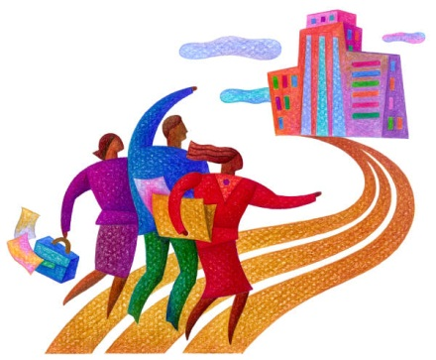

Goal Setting
Goal setting must meet local custom
Goal setting must be clear
Notes:
Goal setting must meet with the expectations which have been set for a particular area. These customs may be national, but are more likely to be regional or local. Goals are handed out as a method to demonstrate authority. Indiscriminate goal setting, results in a consideration of the expatriate as capricious, not strong. Goal setting should be clear and demonstrate thoughtful choice of the goal and the individuals who will be charged with achieving the goal. This demonstrates authority and acceptable use of the expatriate position.
Part of the clarity which is required in goal setting is language, which must be clear. All countries in Latin America demand clarity for goals, so those goals will be best presented in the native language to minimize clarity issues. In cases where the expatriate is not fluent in the language or the local dialect, the goal language should be reviewed with a native speaker. It is best if it can be back translated. By this we mean that the goal be delivered to a native speaker in English, that speaker will deliver the goal in the native language to another employee who speaks both the native language and English, who will in turn deliver the goal back to the expatriate. Through this method, the expatriate can insure that indeed the native language used captures his true intent for the employee.

Slide 10

Goal Setting (cont’d)
Goal setting is often not the norm
Goals must be:
  Heard and
  Understood
Notes:
Goal setting must be heard and understood. Associates may hear the goal, and then disregard it. This is because goals are more often thought of a suggestions or guidelines which are acknowledged but not necessarily required to be acted on. When discussing goals, it is often necessary to discuss the goal along with plans for how to achieve the goal. Setting an appointment with the employee for the express purpose to provide you with a detailed plan to on how to achieve the goal, along with a date to have the plan implemented can be helpful.
Expatriates should expect that they will need to assist employees with goals, especially if the goals requires tight timelines for completion. Success with goal attainment should be swiftly and loudly acknowledged. This type of celebration can result in more willingness to comply with and complete goals on time in the future.

Slide 11
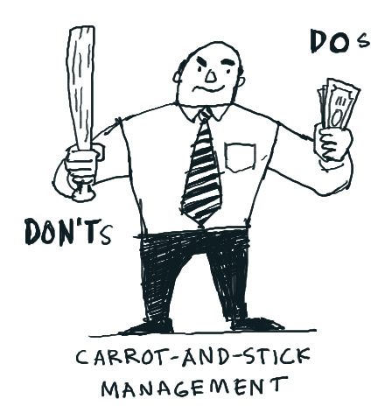

Achievement
Achievement should be rewarded
Recognition is highly prized in Latin America
Position should be given the option to praise
Notes:
In the U.S. the expectation is that employees will accomplish assignments according to goals and timelines. However, this is not the norm in Latin America. Therefore timely accomplishments need to be met with recognition and celebration. Rewards can be celebrations or memo’s but are often met with bonuses. Before setting goals, it may be beneficial to discuss bonus parameters in order to be able to support the achievement.
In rare circumstances where achievement is mission critical, an expatriate can solicit a superior for the ability to grant a title of position. This is not likely to include the performance of another executive. The expatriates superior would most likely pursue an executive move independent of the expat.
This type of recognition is not often given beyond a direct report, however it is always a good idea for an expatriate to inquire if a superior would like to proffer the achievement reward. If the expatriate is a female it is not the norm that she would reward or recognize a males accomplishment. This holds true even if the organization chart would indicate that the female expat should be rewarding the employee.

Slide 12
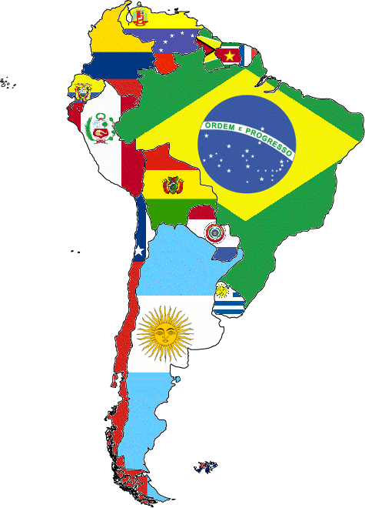
Cultural Expectations
Latin America is highly hierarchical
Age is respected
Notes:
Latin American hierarchical society, dictates that subordinates maintain the appropriate social space with superiors. In the office environment it is also important to follow the chain of command regardless of the delay or problems which it may engender. The chain of command also includes those who have no authority to assist with the project. But, they must still be included.

Slide 13
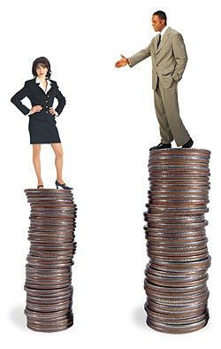

Cultural Expectations (cont’d)
Discrimination on social dimensions is often accepted
  Youth
  Physical beauty
  Ethnic origin
  Gender
Notes:
Age is respected across Latin America.
Experience is highly regarded especially in senior levels of management.
However, for the majority of people in Latin America, the age which is respected and expected is youth. A youthful appearance especially for middle age managers is a sign of wealth and status. So it should not comes as a surprise that discrimination across various social dimensions in not uncommon and in certain cases is acceptable.

Slide 14
Corporate Expectations
Formality is the accepted practice
Punctuality does not always fall within corporate expectations
Notes:
Due to the hierarchical preference of the Latin American culture, formality is expected.
All manner of respect, courtesy and deference is expected to be demonstrated in both social and business settings. The expectation that formal manners be adhered to is often a point of contention with American expatriates. Every effort should be made to respect these customs.
However, contrary to American custom, punctuality is not considered a courtesy. Therefore expatriates will need to relax this domestic custom and defer to the less structured time environment of Latin America.

Slide 15

Navigating Expectations
Greetings are very important
Greetings become more intimate overtime
Notes:
Greetings are very important.
Men upon an initial meeting will shake hands with both men and women, in both social and business settings. However, over time and as relationships develop more intimate connections are made.
Often greetings among peers will share hugs and often kisses on one or both cheeks. This will transpire for both men and women. It is important to remember that this tradition will begin after the first meeting. It is not expected or appreciated for first acquaintances to engage in this more developed form of welcome.

Slide 16


Navigating Expectations (cont’d)
Gifts are no longer expected as a greeting
  However they are often appreciated
Gifts are expected for a visit to a home
  Flowers
  Candy
Notes:
Traditionally, in Latin America first time business encounters (which are planned) resulted in an expectation that the person requesting the meeting would arrive with a gift. While a charming tradition, it is no longer expected. This is not to say that should you arrive bearing a gift that it would be unappreciated.
However, as a cautionary note, knives are never to be given as a gift as it signifies a severing of the relationship.
First time encounters in an individuals home however, continues with the gift bearing tradition. Flowers are the most common gift followed by candy. The gift should be acceptable to all members of a home, so rarely are gifts of alcohol offered if the host has young children.
Additionally, white flowers should not be offered as they represent death and are symbolically used in funeral ceremonies.
Other variations which can occur with regard to gift giving, include:
In Mexico, it is never seen as appropriate to give silver, as it has a cheap connotation
In Venezuela, gifts given with every home visit and those gifts often specifically target the hosts children.
Across Latin America, in keeping with formal tradition, handwritten thank you notes for gifts are expected. These notes are expected regardless of the size of the gift which was given. Failure to provide a thank you note is an affront to the gift giver, and is highly detrimental. While it may be acceptable to thank someone using email in the U.S., it is not in Latin America.

Slide 17

Navigating Expectations (cont’d)
Punctuality has many variations
  Venezuela: punctuality is seen as a sign of greed
  Mexico: promptness will often be met with a long wait
  Costa Rica: punctuality is highly prized
Notes:
Punctuality while not often practiced by Latin Americans, however, it is something which from a business practice is expected of expatriates. Punctuality is almost universally not anticipated for social occasions.
In Costa Rica: punctuality is prized in both business and social setting for all participants, regardless of where they come from and whether they are a host or guest.

Slide 18

Adaptability
Strong personalities and confidence are valued
Personal contact is important
  Personal contact can overcome discriminatory factors
  Employees expect to have face to face contact
Notes:
In keeping with the authority expected of leaders, strong personalities and confidence are valued across Latin America. This is not to be confused with arrogance which seen as highly negative. Humility is also seen as a positive attribute of a confident person in Latin America.
Personal contacts developed through networking are important to maintain. Personal networks are one of the best ways to mitigate the negative impact of discriminatory biases found in Latin America toward appearance, social status, and age.
Personal contact is also an expectation in Latin America. Employees expect communication to be face to face with their superiors.
Contrary to the U.S. this contact should be personal and not electronic.

Slide 19


Adaptability (cont’d)
Strong paternalistic viewpoint
Women need to accept paternalism
  Women rarely are given the same respect as men
  Women should not come to meetings alone
Notes:
Strong paternalistic viewpoint is commonly shared among the countries of Latin America. The U.S. practice of rugged individualism is not shared in Latin America. Generally, elders, superiors and people of influence are seen as important to involve in the decision process.
Women unfortunately need to expect a paternalistic bias in dealings both social and professional in Latin America. Women, however unfortunate rarely receive the same respect as men.
Women are expected to have a male “protector” to attend meetings with them and are not to attend first time social engagements without an escort. This may signal that she unwanted intentions on her behalf toward the others in the social setting.

Slide 20
Latin America
Expatriate Development Series:
International Leadership - Standards
Notes:
Script: This concludes the first section on international leadership in Latin America, standards. The second section, motivation and workplace behavior completes international leadership in Latin America.

