Slide 1
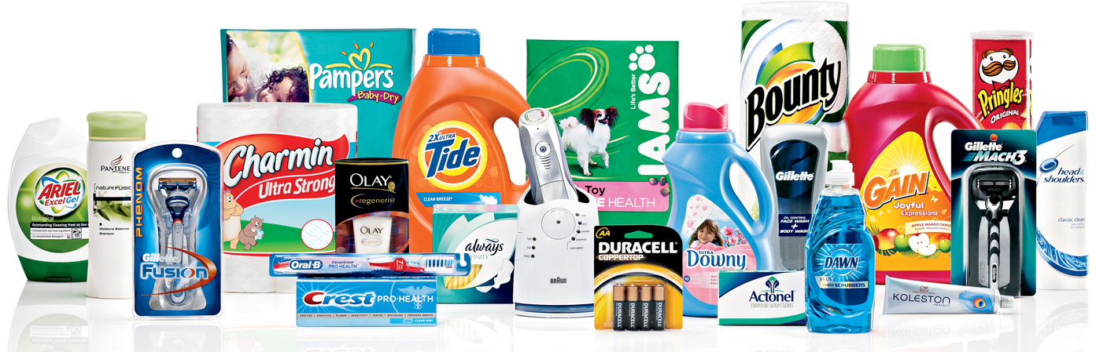
Category Management
History and Development

Slide 2
What is Category Management?
Category
An assortment of products all serving a similar function for the shopper
Category Management
Continuously collaborative process
Retailers and manufacturers manage categories
Purpose
Optimize shopper satisfaction
Vendor
Assortment
Price
Presentation
Promotion

Slide 3
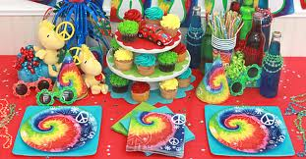
What is Category Management?
Is about understanding data
To maximize category performance
Data drives retailer/manufacturer goals alignment
Shopper need solutions integrate multiple categories and vendors

Slide 4
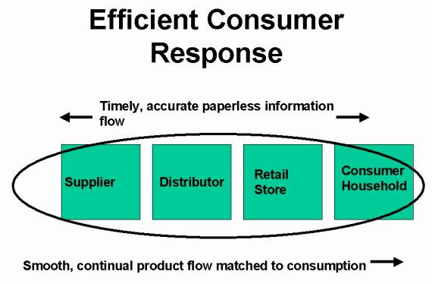
How Did We Get Here?
1980s Japanese total quality movement
Statistical process control
1990s CPG industry forms the Efficient Consumer Response (ECR)
address collaboration concerns across the entire demand and supply chain
The Partnering Group founded in 1991
Gordon Wade, Dr. Brian Harris, and Bill Burns
ECR invites to lead category management development
(Wade, 2013)

Slide 5
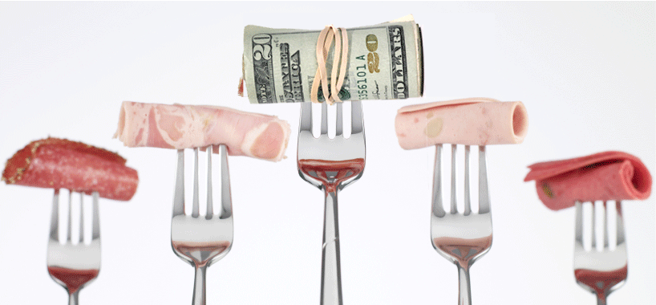
How Did We Get Here?
ECR included all major industry stakeholders
Focus problem solving at the category level
Avoid brand and product level
Shoppers organize around categories
Retailers organized by categories not brands
(Wade, 2013)

Slide 6
What is the “process”?
7 measurable steps
Category Definition
Define by shopper being served
Category Role
Fit in organization
Category Assessment
Opportunities
Definition
Role
Assessment
(Fowler & Goh, 2012)

Slide 7
What is the “process”?
7 measurable steps
Category Performance Measurement
Setting KPI’s and measuring performance
Category Strategies
To deliver results
Category Tactics
Actions to implement strategies
Plan Implementation
Execution
Scorecard
Strategies
Tactics
Implement
REVIEW
(Fowler & Goh, 2012)

Slide 8
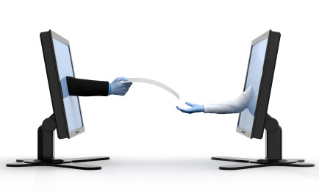
How does it work?
Change the culture
Retailer and manufacturer collaboration
Shared success
Each can be more successful together
Shopper needs
Sharing data to drive decision making
(Wade, 2013)

Slide 9
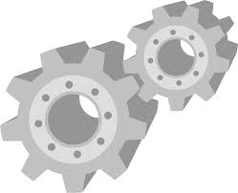
How does it work?
Shopper Focus
Customer for both retailer and manufacturer
Data Analytics
Data from multiple sources
Fact vs Fiction
Insights from data
(Wade, 2013)

Slide 10
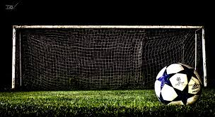
What is the goal?
Increased Profitability
Reduced assortment related costs
Shopper SKU substitutabilty
Focus on key item development
Enable superior performance
Better in-stock
Space utilization
Improved supply chain performance
Introduce new categories/services
(Wade, 2013)

Slide 11
So, who uses category management?
Originally designed for consumer package goods (CPG)
Current Users
Careers Include
Retailers and Manufacturers
Grocery
Big Box retail
DIY chains
Food Service
Federal Government
Merchandising
Space Allocation
Inventory Management
Analytics
Sales
Category Captain
Marketing
Technology
Software Development

Slide 12
Category Management
History and Development

