Slide 1
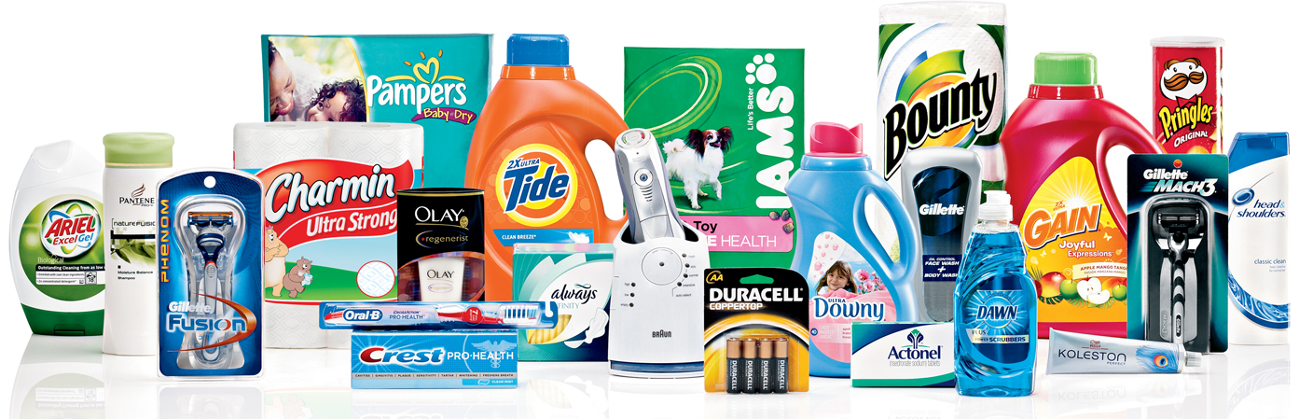
CPG
Basic Consumer Packaged Goods Industry Knowledge

Slide 2
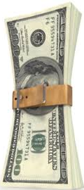
The Current State of Affairs
Consumers and Shoppers are:
Feeling pressed for TIME
Feeling squeezed on their FINANCES
Retailers and Suppliers:
Need to INNOVATE
Provide new and better SOLUTIONS
Provide added VALUE

Slide 3
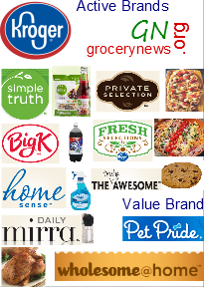
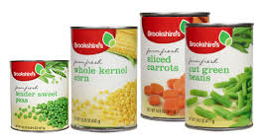
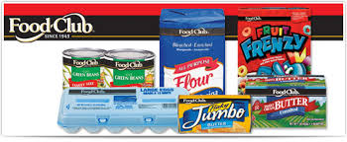
Retailer Response
Finding ways to provide enhanced
Quality
Value
Convenience
Through…
OWN STORE BRANDS

Slide 4
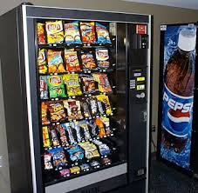
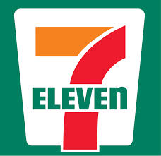
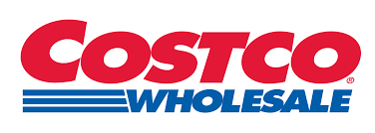
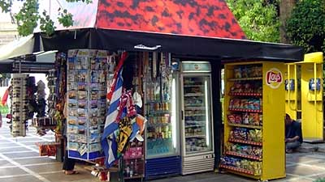
But Which Retailer to Choose?
Consumers and Shoppers
Have more channels to shop in
More retailers to choose from
Shop more frequently
Retailers need a strong identity
To differentiate themselves in a crowded market
Notes:
Traditional grocery outlets: Chains and independents Brookshires Kroger, Brookshire Brothers
Specialty Grocery: Whole Foods, Fresh, Fresh Market, Natural Grocery
Value grocery outlets: Super 1, Aldi
Supercenters and Mass Merchandisers: Target and Walmart
Dollar stores
Pharmacy/Convenience store: CVS, Walgreen
Convenience/Service Station: 7-11, Pilot
Wholesale Clubs: Costco, BJ’s, Sams, Costco
Online
Television

Slide 5
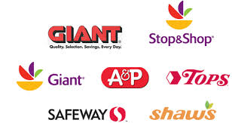
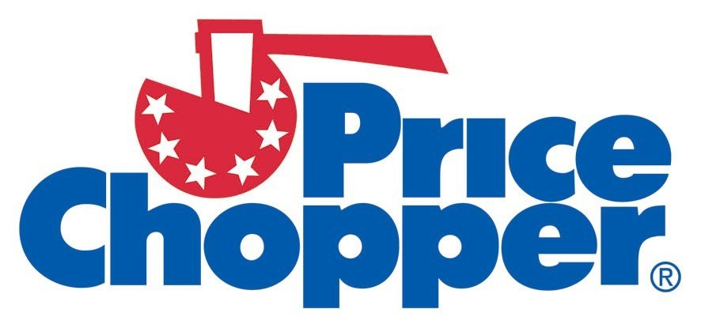
Traditional Grocery
Big Assortment
On average over 43K items stocked
Median sq. ft. over 46K
Median weekly sales $482K
Avg. Sales per customer visit $30.62
Avg. no. of trips per wk/cust.: 1.6
Avg. net profit after taxes: 1.3%
Source: FMI Supermarket facts –
http://www.fmi.org/research-resources/supermarket-facts

Slide 6
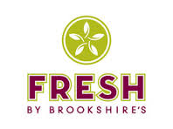
Fresh Format Grocery
Emphasis on perishables
Typically smaller footprint
Specialize in ethnic, natural, and organic foods
May have standards for ingredients in prepared food
Usually large assortment of natural H&B products
Often increased service levels
Margins increased to cover additional labor
Source: FMI Supermarket facts –
http://www.fmi.org/research-resources/supermarket-facts

Slide 7
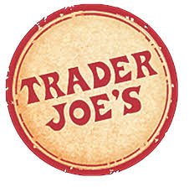
Value/Limited Assortment Grocery
Smaller in size. Bigger in value.
A lower-priced grocery store
Offers a limited assortment
Particularly perishable items
Often offering fewer than 2,000 items
Reduced perishables and footprint reduce overhead
Allows for lower margins and prices
Source: FMI Supermarket facts –
http://www.fmi.org/research-resources/supermarket-facts

Slide 8
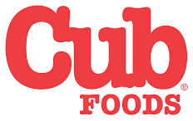
Warehouse Grocery
Hybrid shopping
Large Traditional and Warehouse hybrid - high volume
Full range of service departments
Quality perishables
No frills environment
Case pack displays
High volume and reduced esthetics
Reduced overhead and reduced prices
Source: FMI Supermarket facts –
http://www.fmi.org/research-resources/supermarket-facts

Slide 9
Dollar Stores
Tiny and Cheap
Small store format
Feature aggressive prices
Originally focused on staples and knickknacks
Now offer food and consumables
May account for 20% to 66% of volume
Source: FMI Supermarket facts –
http://www.fmi.org/research-resources/supermarket-facts

Slide 10
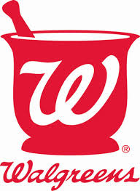
Drug/Pharmacy/Convenience
Prescriptions and convenience
Originally a prescription-based drug store
Expanded into consumables, seasonal, and general merchandise
May generate 20% or more of sales from those categories
Expanding into better H&B
Adding or expanding on-site medical services
Source: FMI Supermarket facts –
http://www.fmi.org/research-resources/supermarket-facts

Slide 11
Convenience/Service Station
Assortment when you need it
Over 151K stores nationwide
Generates over $700b in annual sales
Often offering extended hours
Often offering prepared food
Focus on general merchandise, consumables with limited perishable
Highly visible locations
Often have a restaurant or gas associated with retail
Source: NACS Fact Sheets –
http://www.nacsonline.com/Research/FactSheets/Pages/default.aspx

Slide 12
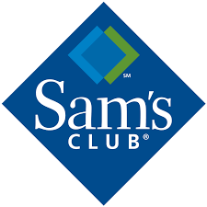
Wholesale Clubs
Stock-up and Save
Membership required – Business and Consumer
Membership helps cover for lowered margins often 12-13%
Varied selection, not often consistent
Comprised of increased sizes and bundles along with bulk sales
Limited assortment - Warehouse-type environment
Avg. 120,000 sq. ft.
60% to 70% of sales GM/HBC and grocery
Source: FMI Supermarket facts –
http://www.fmi.org/research-resources/supermarket-facts

Slide 13
Supercenters/Mass-Merchandisers
One-stop shopping
Broad selections of grocery and general merchandise
Avg. 170K sq. ft.
Appx. 40% of space is grocery
Limited services
Lower prices overall
Kroger marketplace even includes a fine jeweler
Source: FMI Supermarket facts –
http://www.fmi.org/research-resources/supermarket-facts

Slide 14
E-commerce/M-commerce
The ultimate convenience
Includes pure-play online merchants
And online business’ of brick & mortar stores
Brick and click
Fast growing segment
Poses a significant threat to traditional grocery
Heavy emphasis on fresh and prepared foods
Limited selection of general merchandise and non-perishables
Source: FMI Supermarket facts –
http://www.fmi.org/research-resources/supermarket-facts

Slide 15
Television
Trendy and inviting
Offers a broad selection of general merchandise and prepared foods
Includes infomercials which can lead to in-store products
Stable retailers with growing online footprint
Appeal has been limited in the US
Extremely popular in Europe, Australia and the Far East

Slide 16
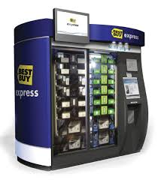
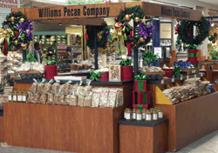
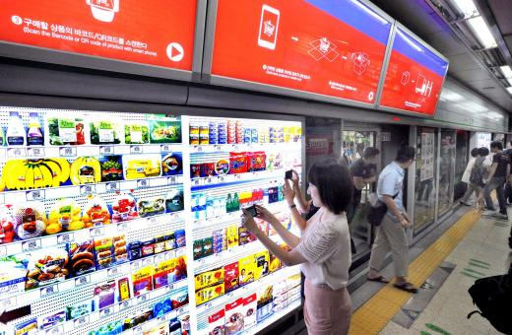
Kiosks and Vending
Ready when you need it
Offers a limited selection of product
Can be placed in very convenient locations
Access through multiple technologies
Credit card
E and M-commerce
Assortment has limited appeal in the US
Extremely popular in the Far East
South Korea the most advanced
Includes delivery services in some cases

Slide 17
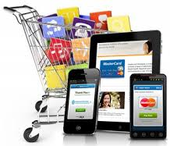
Current Trends
Convenience Stores
Are currently performing well
Changes in shopper habits
Value and especially extreme value
Appealing to a more upscale clientele
Increasing food assortments
Drug/Pharmacy/Convenience
Expanding assortments
Upscaling products
Adding more services
Shoppers are now in control
More retail choices
More purchase channel choices
Access to retailers 24/7

Slide 18
What is Driving Change for Retailers?
Increasingly Global Economy
Influences from other cultures
Travel introducing shoppers to new products and retail
Changing political climates
Changing tastes from immigration
Economic turmoil
Climate change and sustainability
Changing outlook toward energy consumption
Combine to drive changes in shopping habits

Slide 19
Not all Change is Good
Dollar Stores
Generally have low overhead
Food (especially fresh food)
Requires more labor
Loss due-to spoilage
Resulting in higher overhead and tighter margins
These need to be offset with
Tighter margins
Higher prices

Slide 20
Not all Change is Good
Pharmacy Retail
Already have high overhead
Specialized staff
High traffic locations
High assortment counts
Larger assortments
Place even more pressure on overhead
May drive some products out of the store
Increase prices altering consumer perceptions
Onsite medical with nurse practitioners
Increases the costs further for staffing
All of which put pressure on
Margins
Prices

Slide 21
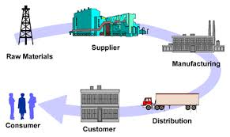
How will that impact retail supply chains?
Different choices for different retailers
Industry terms:
Supply Chain
Distribution System
3 common forms:
Direct
Wholesale
Direct Store Delivery (DSD)

Slide 22
Direct
Manufacturer to Retailer
Product is shipped directly from the supplier to the retailer
Orders need meet certain minimums to qualify
Retailer will accept at a distribution center (DC)
Product is sorted and re-packed to store standards
The retailer then ships to individual stores

Slide 23
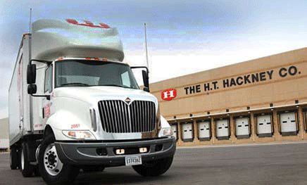
Wholesale Suppliers
Manufacturer to Wholesaler
Product is sold to a wholesaler
Product is shipped from the supplier to the wholesaler
Product is order from the wholesaler by the retailer
These amount are less than the suppliers minimums
Retailer will accept at a distribution center (DC)
Product is sorted and re-packed to store standards
The retailer then ships to individual stores
For additional fees the wholesaler will ship direct to stores

Slide 24
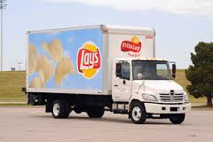
Direct Store Delivery (DSD)
Supplier to Store
Product is purchase and shipped from the supplier to individual stores
In certain cases the supplier may actually stock the shelve
Product is placed immediately into the selling space not into stock
This method reduces merchandise handling
Which results in reduced overhead
However, the increased service can result in increase cost of goods
Requires real-time inventory and ordering processes

Slide 25
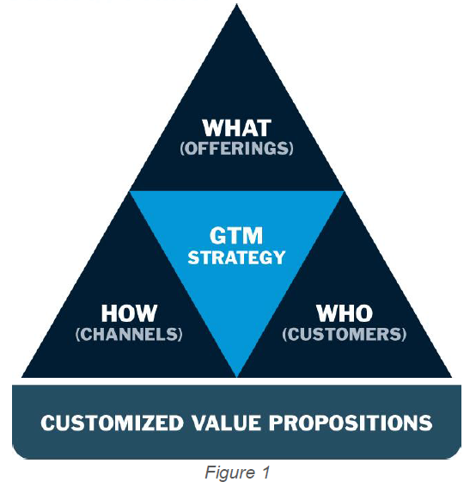
Go to Market Strategy
Retailers approach to the marketplace
Different strategies require different:
Store configurations
Fixtureing and amenities
Service offerings
Distribution strategies
In-store staffing
Stock space
Some of the strategies are:
Every Day Low Prices (EDLP)
Hi - Lo
Hybrid
Limited Assortment
Dollar Store

Slide 26
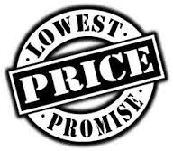
Every Day Low Prices (EDLP)
Consistency builds Confidence
Offers the lowest available price to shoppers everyday
Eliminates sales advertising
Reduces the use of discounts
Strategy offer shoppers price simplicity
Understandable value
Do not have to wait for sales
Helps to develop loyalty
EDLP does not guarantee the “lowest” price in the market
Other retailers can offer promotions at lower prices
Notes:
See retailers like Wal-mart, Wegmans,

Slide 27
Hi - Lo
Drive Traffic to Target Product
Offers higher daily prices to shoppers
Selectively offer lower prices
Weekly ads and promotions
Selected items are designed to drive traffic
Many shoppers are motivated by the lowered prices
Thrill of scoring a “deal”
Feel like they beat the system
Competes with EDLP through sale items at lower prices
Hi-Lo may not engender loyalty
Shoppers continue to search for retailers offering lower prices
Notes:
See retailers like Harris Teeter, Kroger, Brookshires, JC Penney, Macy’s

Slide 28
Hybrid
A little bit for everyone
Offers higher daily prices to shoppers
Selectively offer lower prices
Weekly ads and promotions
Selected key items are designated EDLP
Usually highly identifiable
Helps to develop a lower price reputation with shoppers
Perceived more competitive in the market
Hybrid may not engender loyalty
Shoppers continue to search for retailers offering lower prices
EDLP items may also be at lower prices at some competitors
Notes:
See retailers like Publix and Super 1

Slide 29
Limited Assortment
Limited choices better value
Offers limited variety of SKU’s
Often products unique to the retailer under their own label
Offered at very competitive pricing
Stores are often
Configured to a much smaller footprint
Offer limited services
In less prime locations
Results in lower overhead
Which allows for lower prices
Difficult to convert national brand loyal shoppers to the store
Notes:
See retailers like Publix and Super 1

Slide 30
Dollar Store
Limited choice for the retailer and Shopper
Offers limited to a narrow price band
Often a $1 or some multiple for a $1
Offered at very competitive pricing
Stores are
Small footprint, almost no services, less prime locations
Focus on basic merchandise
High turn, limited assortment, household goods and general merchandise
Results in lower overhead to accommodate the price restriction
New product offerings and expanded customer base may make it difficult for the dollar store to maintain it primary focus of the dollar price-point.
Notes:
See retailers like Publix and Super 1

Slide 31
CPG
Basic Consumer Packaged Goods Industry Knowledge

